Slide 1


CS106A: Programming Methodologies

Slide 2
Chris Piech
My parents are interesting folks
I originally concentrated in graphics and worked at Pixar
Childhood: Nairobi, Kenya
High School: Kuala Lumpur, Malaysia
Stanford University Ph.D. in Neural Networks
Research lab on AI for Social Good
The problem I really want to solve is to make high quality more education accessible

Slide 3
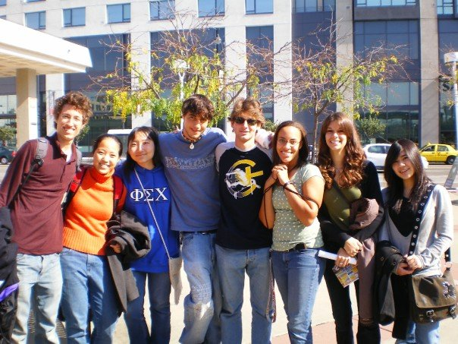
Chris Piech
11 years ago to this day, I was sitting in your seats

Slide 4
Head TA: Julia Daniel

Slide 5
Section Leaders

Slide 6
Course mechanics
(this is a light version. Please read the handout for details).

Slide 7
Course Website
http://cs106a.stanford.edu

Slide 8
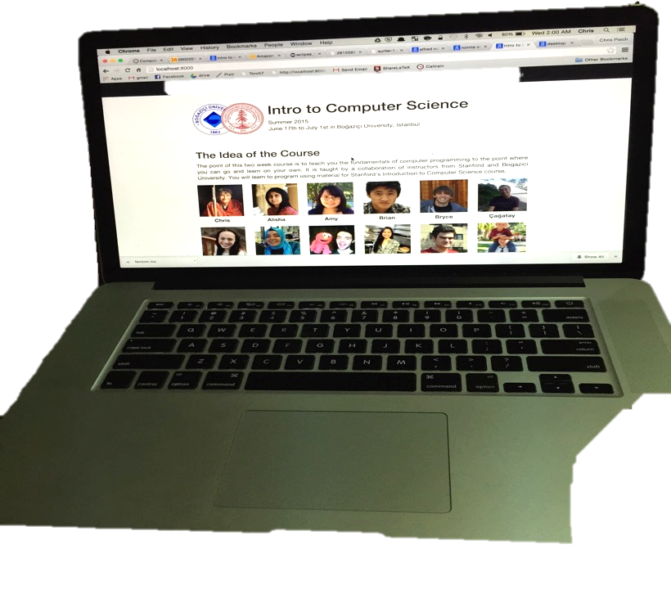

Prerequisite Test

Slide 9
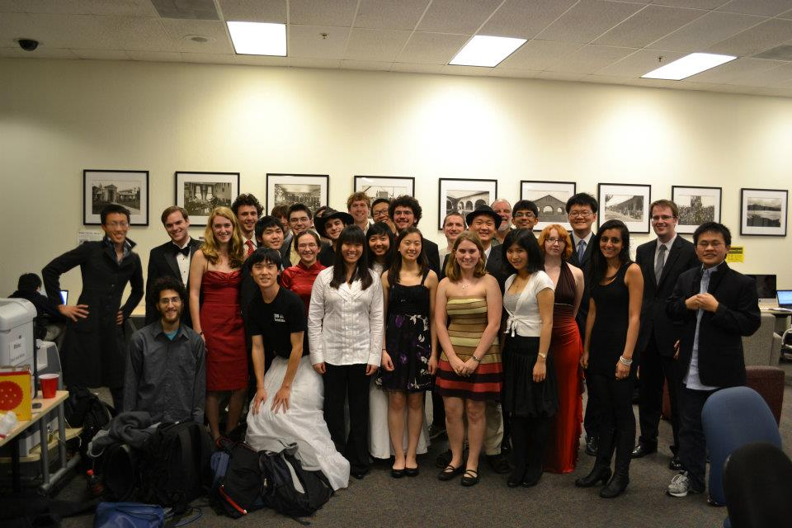
Lectures and Sections
Weekly 50-min section led by awesome section leaders (the backbone of the class!)
Signups begin on Thursday at 5:00pm and close Sunday at 5:00pm

Slide 10
Office Hours
LaIR: 7pm until 11pm Sunday through Thursday
(starting next Sunday)

Slide 11


Grading Scale
Functionality and style grades for the assignments use the following scale:
A submission so good it “makes you weep.”
Exceeds requirements.
Satisfies all requirements of the assignment.
Meets most requirements, but with some problems.
Has more serious problems.
Is even worse than that.
Better than nothing.

Slide 12
What we will ask you to do
*Two free late days

Slide 13
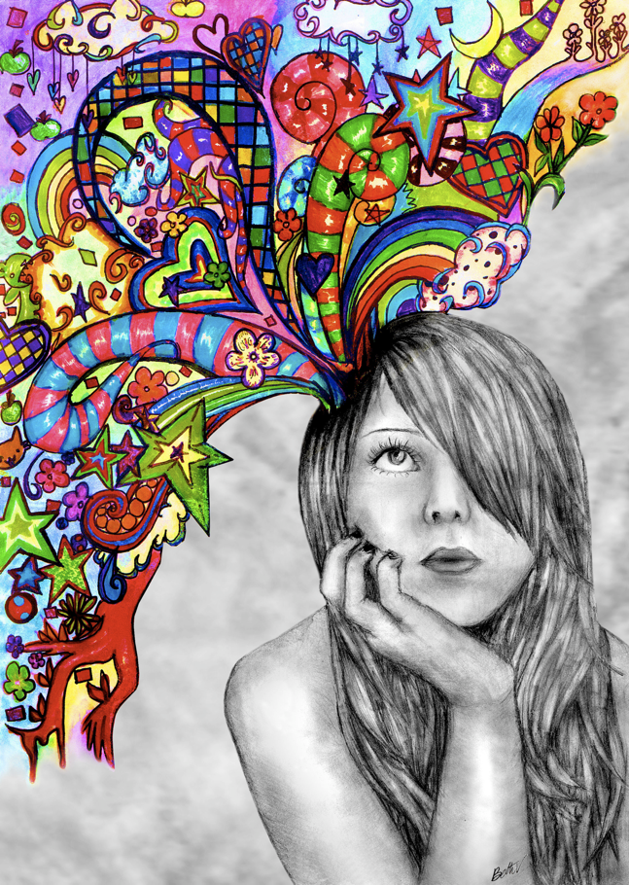
Optional Contest

Slide 14
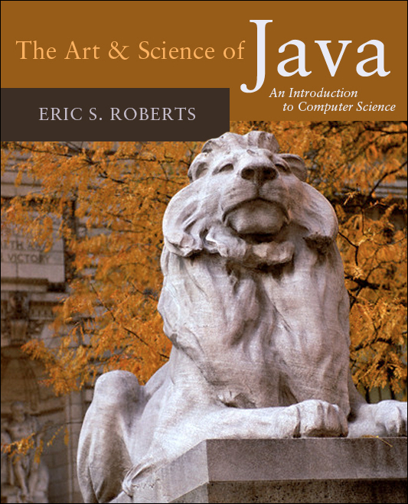
Textbook
The Art & Science of Java by Eric Roberts
written here at Stanford
tailored to this course
a valuable reference
usable on open-book exams
Karel the Robot Learns Java
First week of material

Slide 15
CS106A Units
Start Here
Average about 10 hours / week for assignments
Are you an
undergrad or
SCPD
student?
Do you want
to take CS106A for
fewer units?
No
Yes
3 Units
-or-
4 Units
Yes
No
5 Units

Slide 16
Are you in the right place?

Slide 17
What is CS106A?

Slide 18
Computer Science
Computer science is no more about computers than astronomy is about telescopes, biology is about microscopes or chemistry is about beakers and test tubes. Science is not about tools, it is about how we use them and what we find out when we do.
- Michael Fellows and Ian Parberry

Slide 19
Learning Goals
Learn how to harness computing power to solve problems.
To that end:
Explore fundamental techniques in computer programming.
Develop good software engineering style.
Gain familiarity with the Java programming language.

Slide 20
There are a lot of cool programs you may one day write

Slide 21
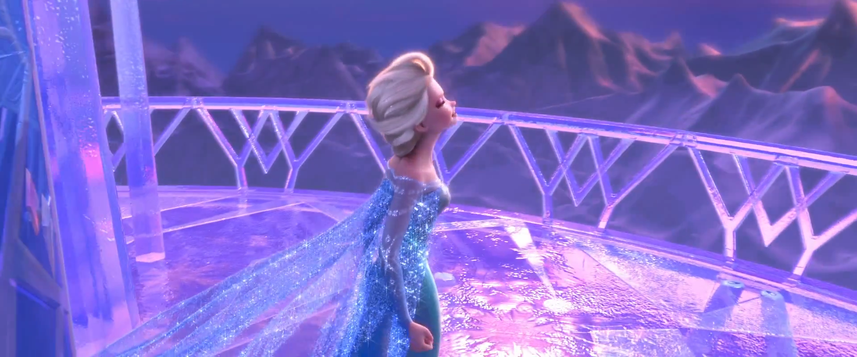
Computer Graphics
Pat Hanrahan, one of the founders of Pixar is a professor here

Slide 22
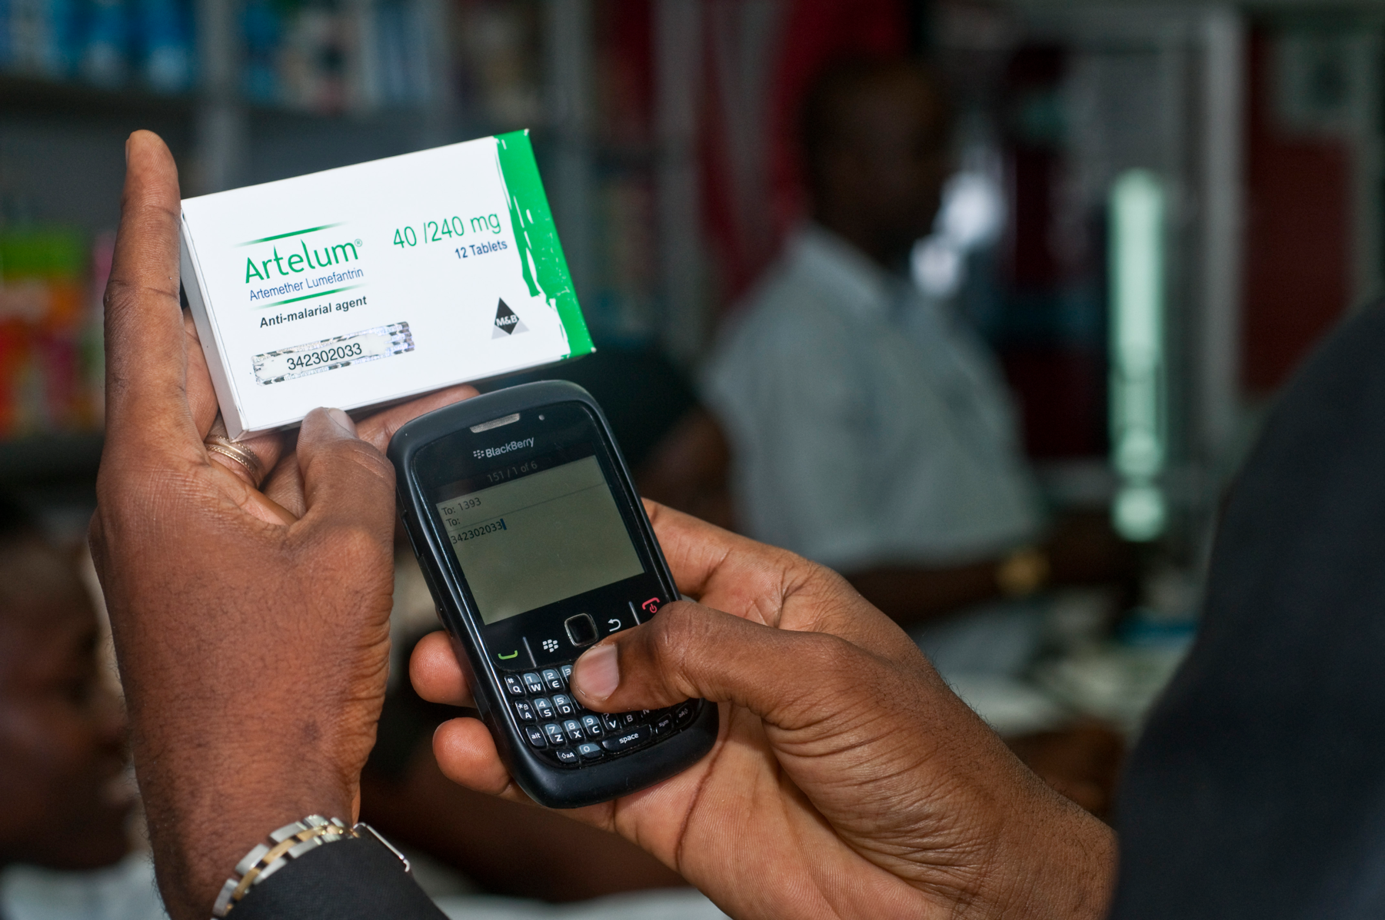
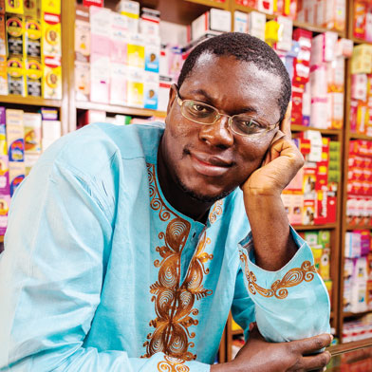
Consumer Applications
Notes:
Estimated 700,000 deaths from fame malaria and TB drugs in 2013:
http://www.un.org/africarenewal/magazine/may-2013/counterfeit-drugs-raise-africa%E2%80%99s-temperature
Bright Simmons from Ghana made an application which let people verify if their medication was authentic

Slide 23
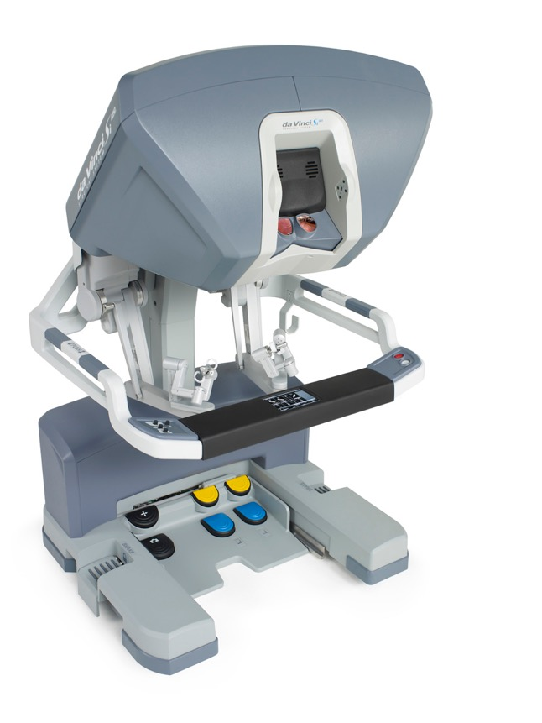
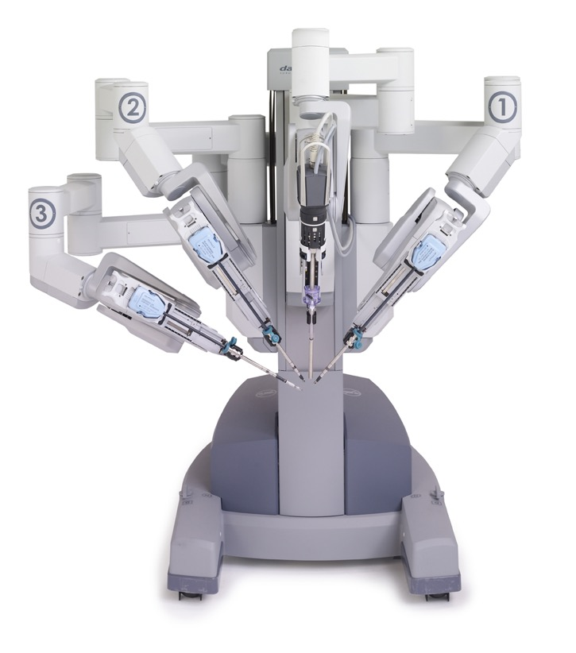
Autonomous Surgery
(c) 2012 Intuitive Surgical, Inc.

Slide 24
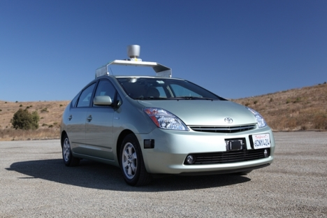
Self Driving Car

Slide 25
If only we could program self driving cars…

Slide 26
Graphical Games

Slide 27
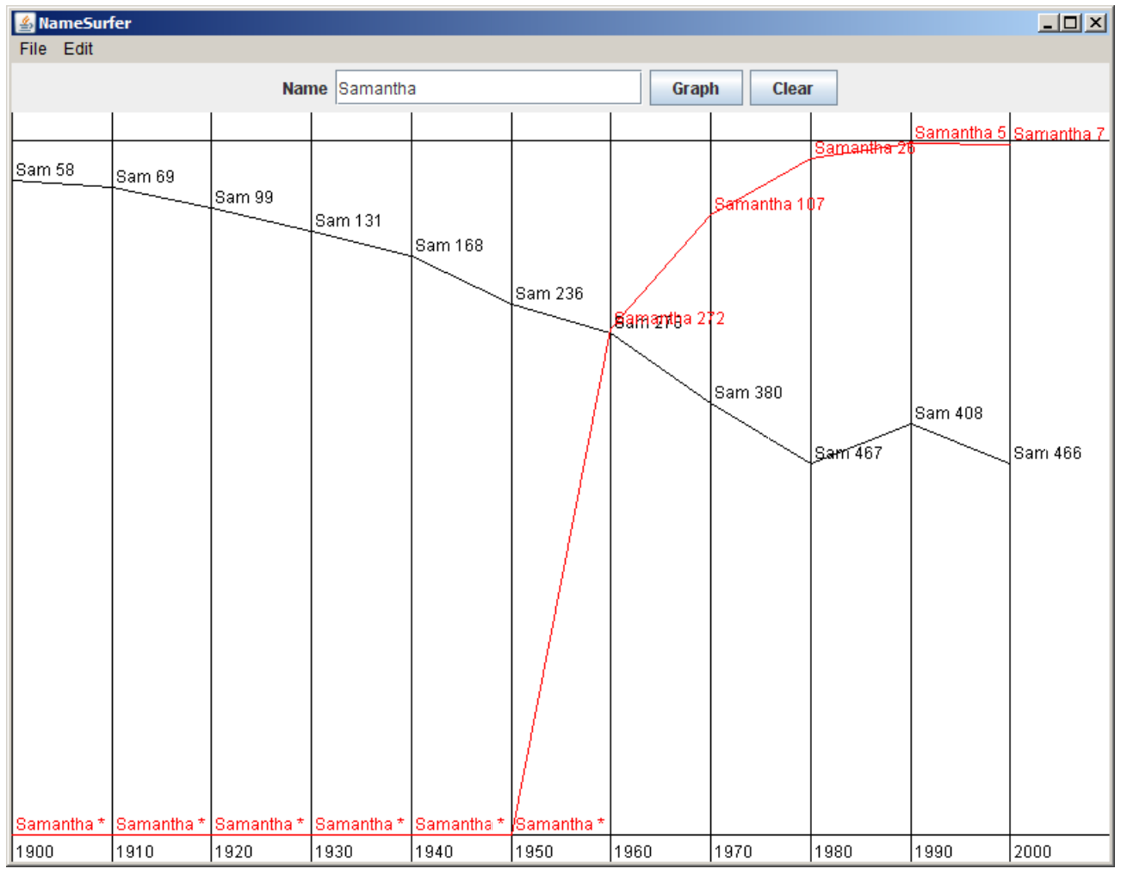
Data Visualization

Slide 28
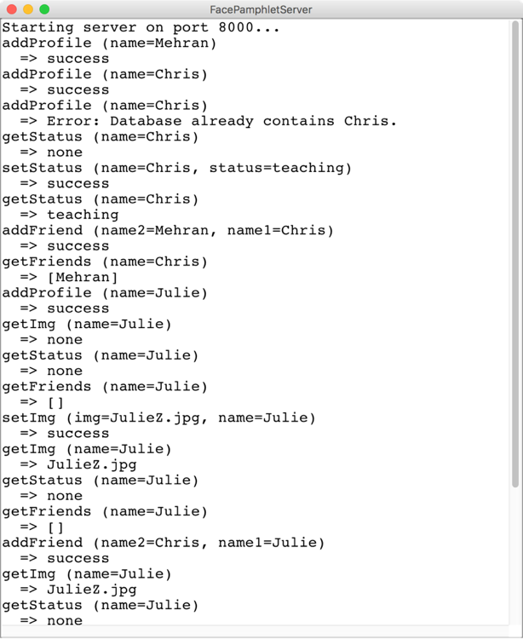
Internet Based Program

Slide 29
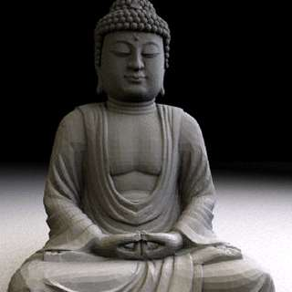
Art of Computer Science
Notes:
We teach software engineering principles. Much larger than just programming.
Mechanics of the language are nothing compared to the principles.
You are going to learn the principles by programming in Java

Slide 30
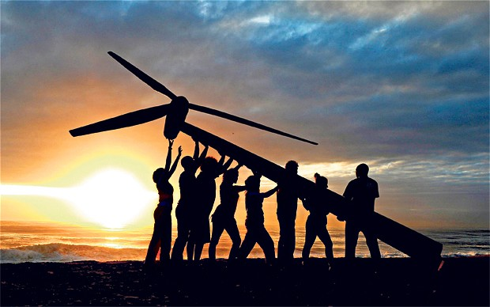
Strive for Everyone to Succeed
Notes:
We want all of you to be successful
That’s why we have such a large course staff
And its not like it’s a ya-ya course where we all hold hands and sing koombaya. Its real material.
But over years and years and years we have been working on our material so that everyone gets through…
Not competing against anyone but yourself

Slide 31
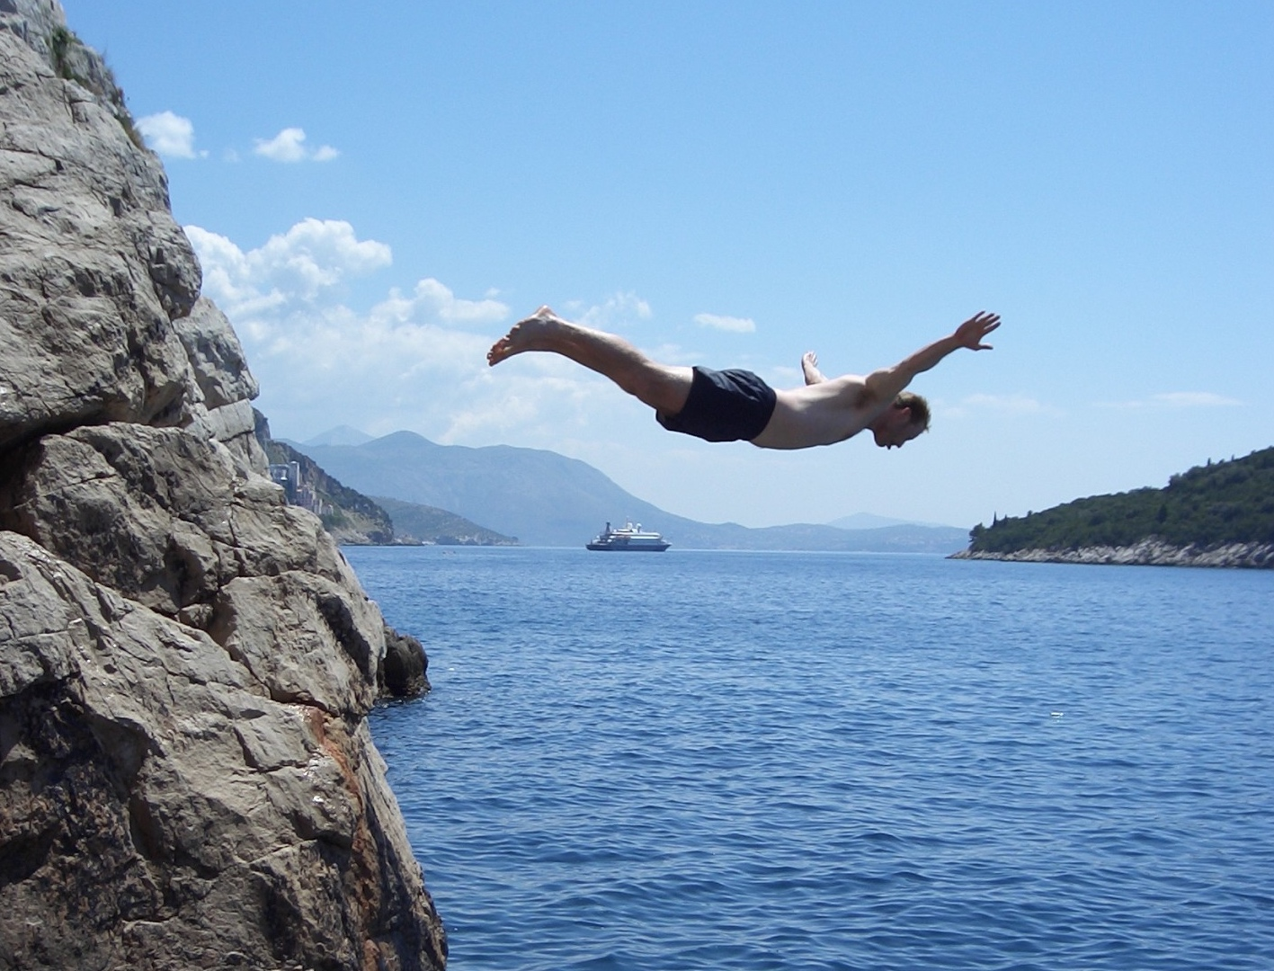
Lets Get Started

Slide 32
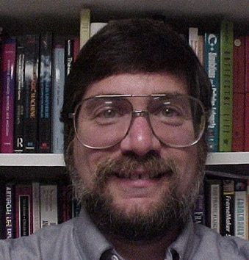

Meet Karel the Robot
Good morning
Notes:
He looks like an old machintosh machine.
Hes got legs… one sticks out the back. That’s just the way it is.

Slide 33

Karel Speaks Java
s
Notes:
Tomorrow you will learn that Karel is actually a very gentle introduction to programming

Slide 34
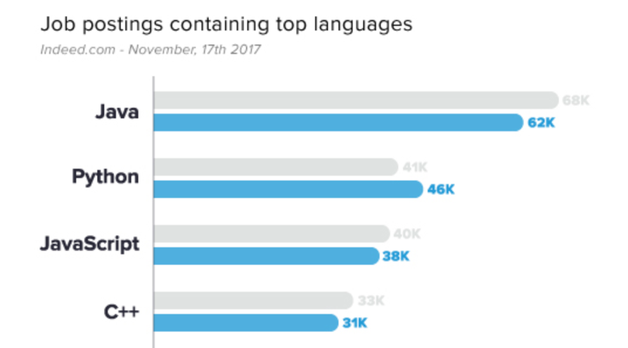
Why Java?
1
2
http://www.codingdojo.com/blog/7-most-in-demand-programming-languages-of-2018/

Slide 35


Karel’s World
North
3
+
+
+
+
+
2
+
+
+
+
+
West
East
1
+
+
+
+
+
South
1
2
3
4
5
Notes:
To you it might not be exciting but to karel its very exciting.

Slide 36

Walls
3
+
+
+
+
2
+
+
+
+
1
+
+
+
+
1
2
3
4

Slide 37

Beepers
3
+
+
+
+
2
+
+
+
+
1
+
+
+
+
1
2
3
4

Slide 38
Knows Four Commands
move();
turnLeft();
putBeeper();
pickBeeper();
Notes:
Tomorrow you will learn that Karel is actually a very gentle introduction to programming

Slide 39
move();

Slide 40

move();
3
+
+
+
+
2
+
+
+
+
1
+
+
+
+
1
2
3
4

Slide 41
move();
3
+
+
+
+
2
+
+
+
+
1
+
+
+
+
+
1
2
3
4

Slide 42
turnLeft();

Slide 43
turnLeft();
3
+
+
+
+
2
+
+
+
+
1
+
+
+
+
+
1
2
3
4

Slide 44
turnLeft();
3
+
+
+
+
2
+
+
+
+
1
+
+
+
+
+
1
2
3
4

Slide 45
pickBeeper();

Slide 46
pickBeeper();
3
+
+
+
+
2
+
+
+
+
1
+
+
+
+
+
1
2
3
4

Slide 47
pickBeeper();
3
+
+
+
+
2
+
+
+
+
1
+
+
+
+
+
1
2
3
4

Slide 48
Make Sense?

Slide 49
First Challenge
3
+
+
+
+
+
2
+
+
+
+
+
1
+
+
+
+
+
1
2
3
4
5

Slide 50
First Challenge
3
+
+
+
+
+
2
+
+
+
+
+
1
+
+
+
+
+
1
2
3
4
5

Slide 51
Bird’s Eye View
3
+
+
+
+
+
2
+
+
+
+
+
1
+
+
+
+
+
1
2
3
4
5

Slide 52
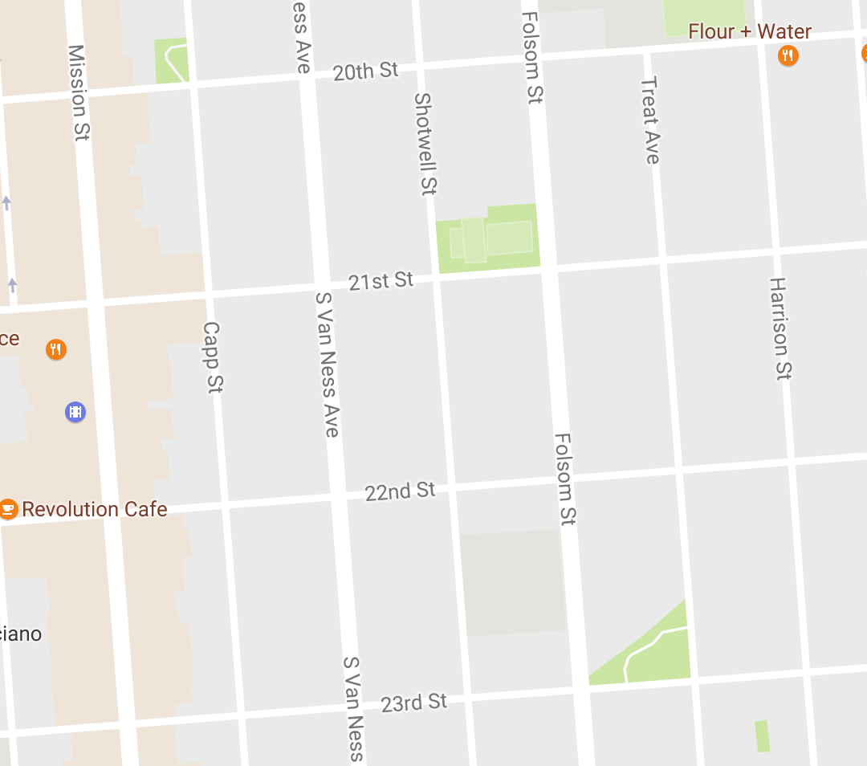
Bird’s Eye View
Karel is facing East

Slide 53
Turn Left
Karel is facing North

Slide 54
Turn Left
Karel is facing West

Slide 55
Turn Left
Karel is facing South

Slide 56
Move

Slide 57
First Challenge
3
+
+
+
+
+
2
+
+
+
+
+
1
+
+
+
+
+
1
2
3
4
5

Slide 58
First Challenge
3
+
+
+
+
+
2
+
+
+
+
+
1
+
+
+
+
+
1
2
3
4
5

Slide 59
First Challenge
3
+
+
+
+
+
2
+
+
+
+
+
1
+
+
+
+
+
1
2
3
4
5

Slide 60

Learn By Doing

Slide 61


Slide 62
Method Definition
private void name() {
method statements
}
This adds a new command to Karels vocabulary

Slide 63
Anatomy of a Program
Import Packages
Program

Slide 64
Anatomy of a Program
Import Packages
public class OurKarelProgram extends Karel {
}

Slide 65
Anatomy of a Program
Import Packages
public class OurKarelProgram extends Karel {
}
run method
helper methods

Slide 66
Anatomy of a Program
Import Packages
public class OurKarelProgram extends Karel {
}
public void run() {
move();
pickBeeper();
move();
turnLeft();
move();
turnRight();
move();
putBeeper();
move();
}
helper methods

Slide 67
Anatomy of a Program
Import Packages
public class OurKarelProgram extends Karel {
}
public void run() {
move();
pickBeeper();
move();
turnLeft();
move();
turnRight();
move();
putBeeper();
move();
}
private void turnRight() {
turnLeft();
turnLeft();
turnLeft();
}

Slide 68
Anatomy of a Program
import stanford.karel.*;
public class OurKarelProgram extends Karel {
}
public void run() {
move();
pickBeeper();
move();
turnLeft();
move();
turnRight();
move();
putBeeper();
move();
}
private void turnRight() {
turnLeft();
turnLeft();
turnLeft();
}

Slide 69
Anatomy of a Program
import stanford.karel.*;
public class OurKarelProgram extends Karel {
}
public void run() {
move();
pickBeeper();
move();
turnLeft();
move();
turnRight();
move();
putBeeper();
move();
}
This piece of the program's source code is called a method.
private void turnRight() {
turnLeft();
turnLeft();
turnLeft();
}

Slide 70
Anatomy of a Program
import stanford.karel.*;
public class OurKarelProgram extends Karel {
}
public void run() {
move();
pickBeeper();
move();
turnLeft();
move();
turnRight();
move();
putBeeper();
move();
}
x
This line of code gives the name of the method
(here, run)
private void turnRight() {
turnLeft();
turnLeft();
turnLeft();
}

Slide 71
Anatomy of a Program
import stanford.karel.*;
public class OurKarelProgram extends Karel {
}
public void run() {
move();
pickBeeper();
move();
turnLeft();
move();
turnRight();
move();
putBeeper();
move();
}
This line of code gives the name of the method
(here, turnRight)
private void turnRight() {
turnLeft();
turnLeft();
turnLeft();
}

Slide 72
Anatomy of a Program
import stanford.karel.*;
public class OurKarelProgram extends Karel {
}
public void run() {
move();
pickBeeper();
move();
turnLeft();
move();
turnRight();
move();
putBeeper();
move();
}
This is called a code block
private void turnRight() {
turnLeft();
turnLeft();
turnLeft();
}

Slide 73
Anatomy of a Program
import stanford.karel.*;
public class OurKarelProgram extends Karel {
}
public void run() {
move();
pickBeeper();
move();
turnLeft();
move();
turnRight();
move();
putBeeper();
move();
}
This is called a code block
private void turnRight() {
turnLeft();
turnLeft();
turnLeft();
}

Slide 74
Anatomy of a Program
import stanford.karel.*;
public class OurKarelProgram extends Karel {
}
public void run() {
move();
pickBeeper();
move();
turnLeft();
move();
turnRight();
move();
putBeeper();
move();
}
This is also called a code block
private void turnRight() {
turnLeft();
turnLeft();
turnLeft();
}

Slide 75
Anatomy of a Program
import stanford.karel.*;
public class OurKarelProgram extends Karel {
}
public void run() {
move();
pickBeeper();
move();
turnLeft();
move();
turnRight();
move();
putBeeper();
move();
}
private void turnRight() {
turnLeft();
turnLeft();
turnLeft();
}

Slide 76
Anatomy of a Program
import stanford.karel.*;
public class OurKarelProgram extends Karel {
}
public void run() {
move();
pickBeeper();
move();
turnLeft();
move();
turnRight();
move();
putBeeper();
move();
}
The run method is “public” so that Eclipse can call it.
private void turnRight() {
turnLeft();
turnLeft();
turnLeft();
}

Slide 77
Anatomy of a Program
import stanford.karel.*;
public class OurKarelProgram extends Karel {
}
public void run() {
move();
pickBeeper();
move();
turnLeft();
move();
turnRight();
move();
putBeeper();
move();
}
The turnRight method is “private” to indicate it is only visible to our current program.
private void turnRight() {
turnLeft();
turnLeft();
turnLeft();
}

Slide 78
Why Study CS?

Slide 79
Joy of Building

Slide 80
Interdisciplinary

Slide 81

Closest Thing To Magic

Slide 82
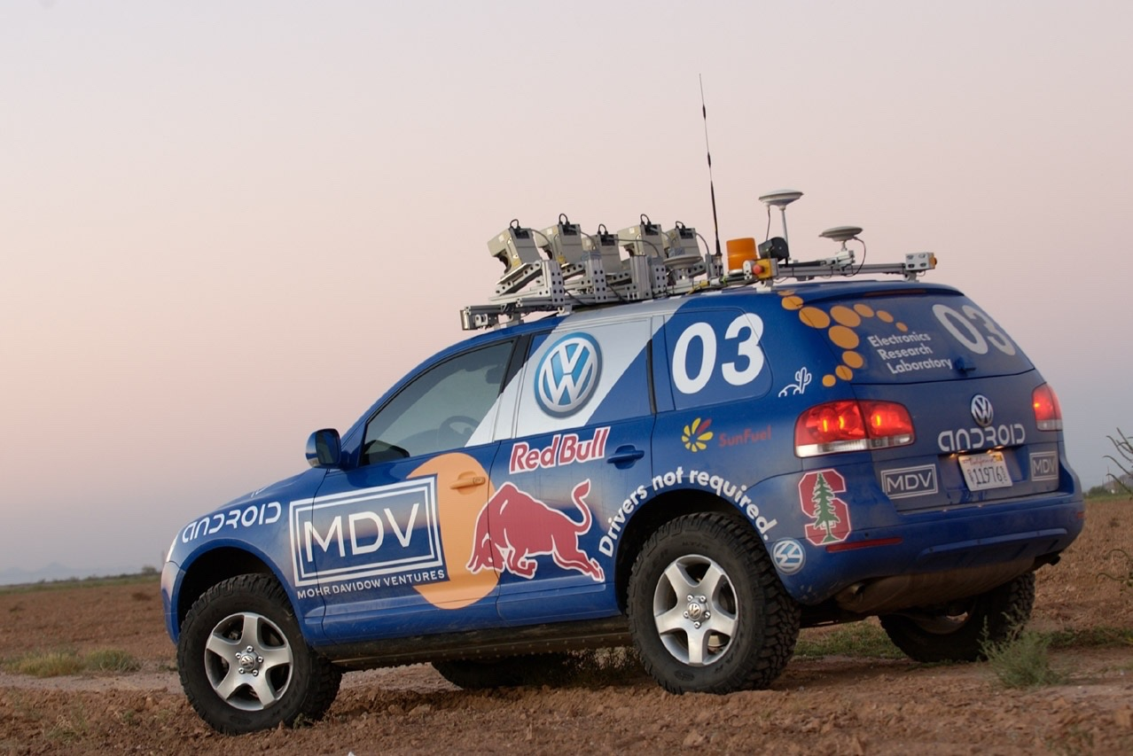
Now is the Time

Slide 83
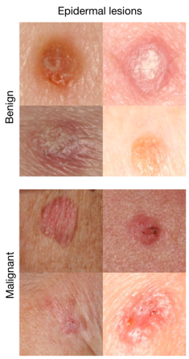
Where is this useful?
Now is the Time
A machine learning algorithm performs better than the best dermatologists.
Developed this year, at Stanford.
Esteva, Andre, et al. "Dermatologist-level classification of skin cancer with deep neural networks." Nature 542.7639 (2017): 115-118.
Esteva et al., Nature 2017.

Slide 84
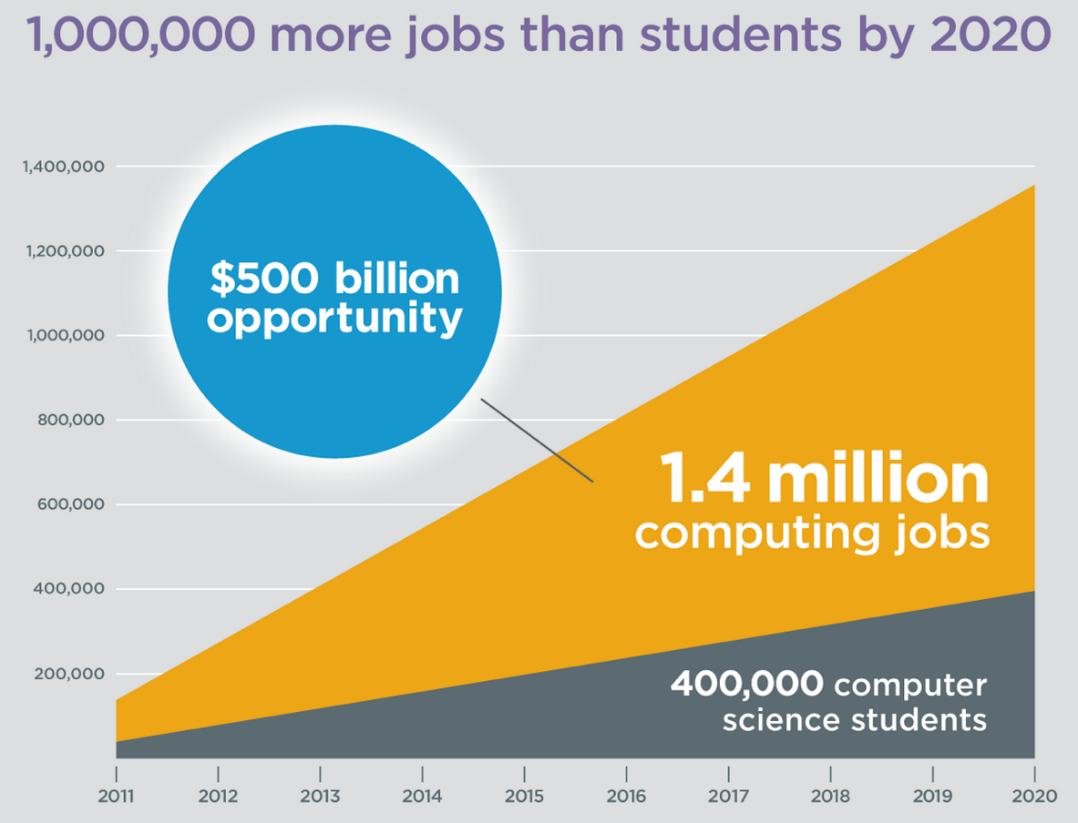
Oh and Its Useful
Code.org

Slide 85
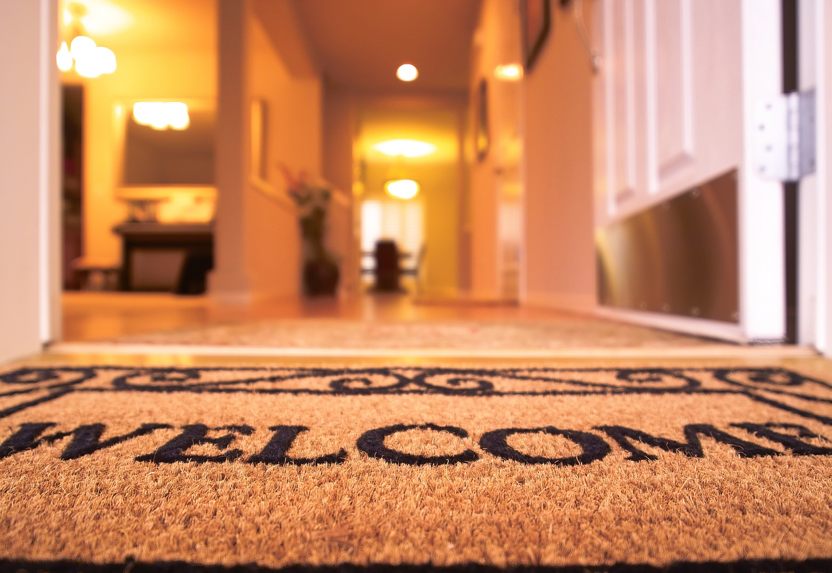
Everyone is Welcome
Notes:
One of my favorite things about programming is that we are all equal infront of Eclispe.
Eclipse does not care your ethnicity, gender, orientation.
That theme is part of the essence of CS106A.
Last night Oprah talked about the new day that is on the horizon! CS too is having a new day and it is very exciting future for the phenomenal women and men sitting in this classroom.

Slide 86
The End

Slide 87
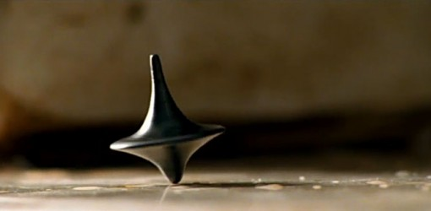
The End?

Slide 88
Who are you?

